Slide 1
Applications of Natural Language Processing

Slide 2
Applications of Natural language Processing
Search Assistant : - is also called Speech to Text, is the Task of Reliably converting voice data into text Data.
Search Assistant is that follows the voice Commands and Text Commands.
it’s challenging is the way people talk quickly, slurring words together, Varying emphasis and intonation.

Slide 3
Cont.
For Example : Siri
“Hey siri what’s the Weather like?”
Siri uses a Variety of Advance Machine learning Technologies to be able to understand your command and return a response.

Slide 4
Cont.
Spam Detection : - The best Spam Detection Technologies use NLP Text Classification Capabilities to scan emails for language.
Spam or phishing these indicator can include overuse of financial terms, Characteristics, bad grammar.

Slide 5
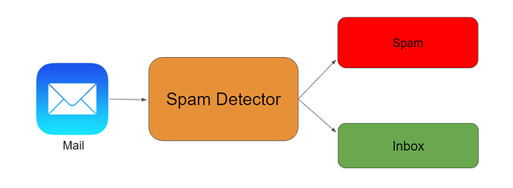
Cont.

Slide 6
Cont.
Machine Translator :- Truly useful Machine Translator involves more than Replacing words.
in one language with words of another.
The meaning and Tone of the input language and translate it to text with the same meaning and desired in the output language.
For Example - Google Translator

Slide 7
Cont.
Social Media Sentiment Analysis :- Sentiment Analysis can Analyze language used in Social Media Post, Responses, Reviews and More extract to attitude and Emotions.
This Promotions and even information Companies can use in Product Design, advertising Champaign and More.

Slide 8
Cont.
Text Summarization :- The Text Summarization uses NLP Techniques to digest huge volume of digital text and Create Summaries.
The best Text Summarization Application use Semantic Reasoning and Natural language generation to add useful Contexts and Conclusion to summaries.

Slide 9
Cont.
Predictive Text :- Things like Autocorrect, Auto complete and Predictive text are so commonplace on our smart phones that we them take them for granted.
Auto complete and predictive text are similar to search engine in that they predict things to say based on what you type

Slide 10
Cont.
Digital Phone Calls :- We all are hear “This Call may be Recorded for Training Purpose”, Turns out these Recording may be use for Training Purpose they go into the Data base of NLP System to learn from and improve the future.
Automated System direct Customer Call to a system to learn from and improve in the system.
NLP also enables computer generated language close to the voice of human.

Slide 11
Cont.
Data Analysis :- Natural language capabilities are integrated into Data Analysis workflow as more BI Vendors are offer a natural language interface to Data Visualization.
Smart Visual encodings, offering up the best visualization for the right task based on the semantic of the data.
This opens up more opportunities for people to explore there data using natural language statements or Question fragments.

Slide 12
Cont.
Text Analytics :- Text Analytics Converts unstructured Text Data into Meaningful data for Analysis using different linguistic, statistical, and Machine learning Techniques.
While sentiment Analysis sounds daunting to brands specially they have large customer base a tool using NLP will typically scour customer interaction, such as social media comments and Review etc.

Slide 13
Thank you

